Slide 1


Measures of natural selection
EMBO practical course 2017
Pascale Gerbault
p.gerbault@westminster.ac.uk

Slide 2
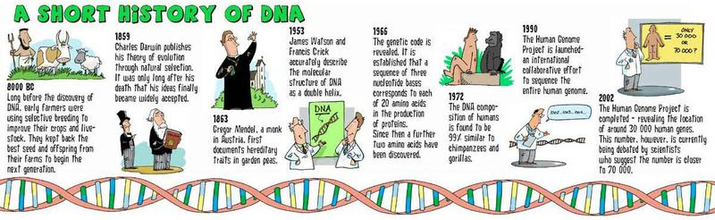

Slide 4
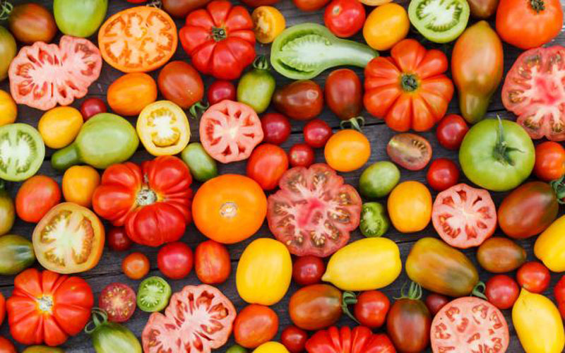
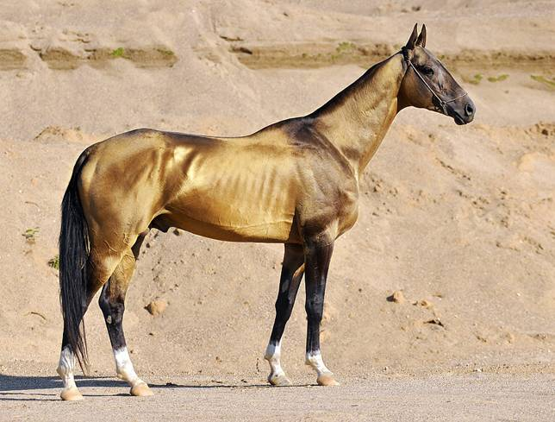
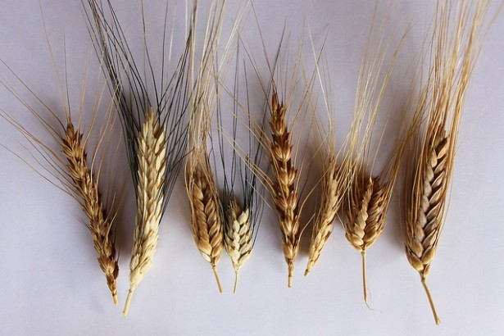
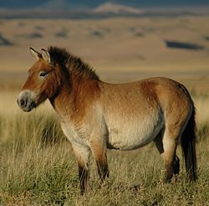
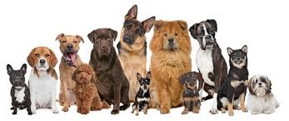
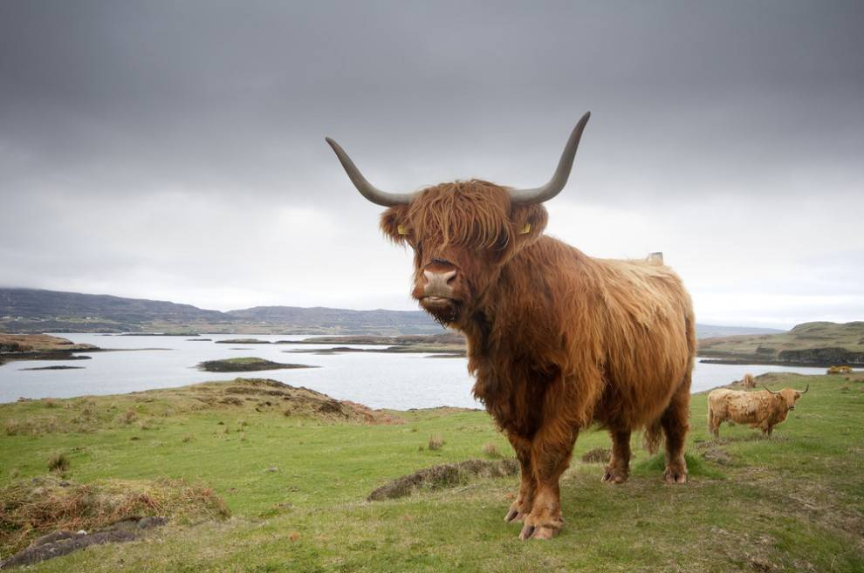
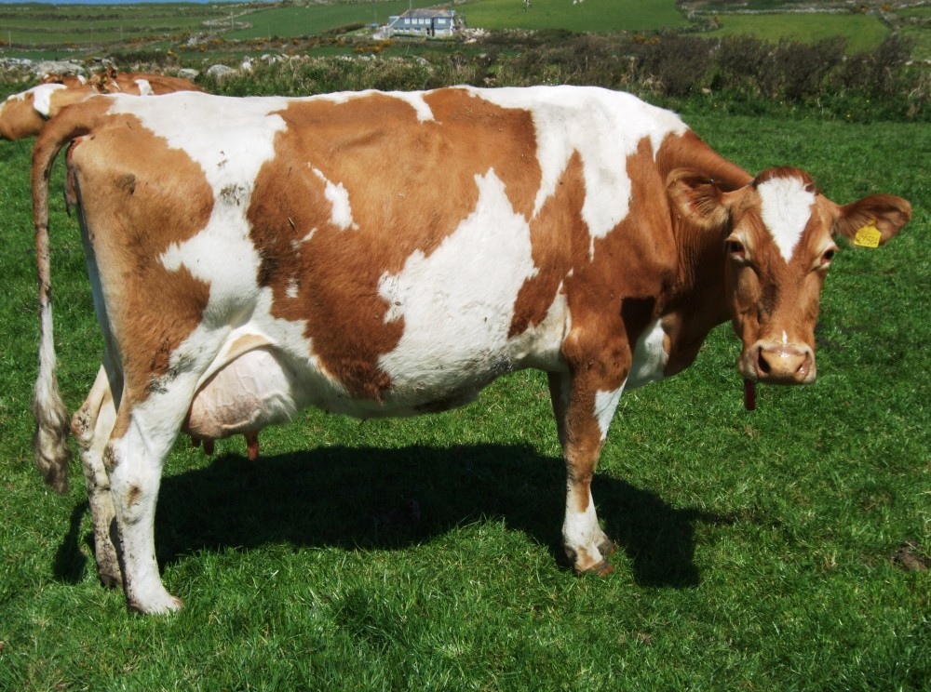
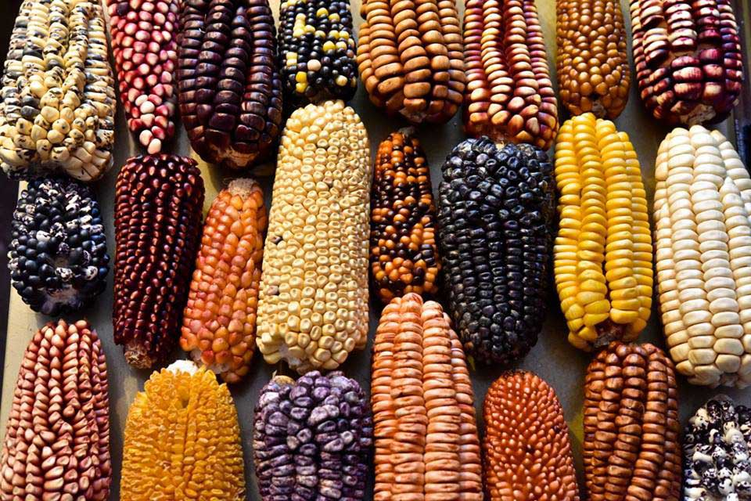
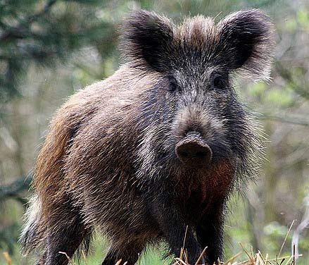
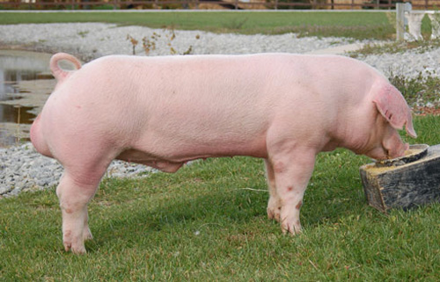
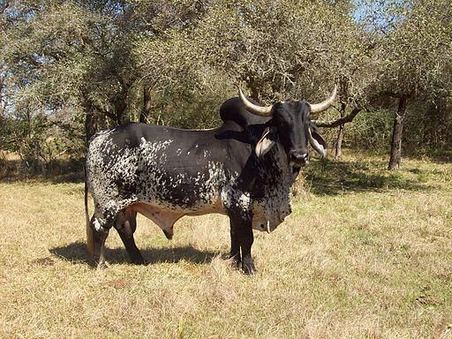
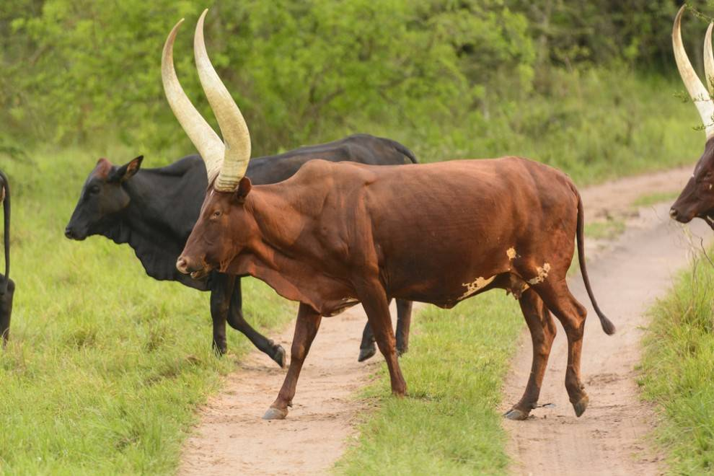
Why are Mendel’s and Darwin’s works still relevant today?
Examples of deliberate cross breeding…
=> possible because most populations are genetically variable

Slide 5
Darwinian concepts of selection have been rendered quantitative and measurable in real populations, thanks to methodological and technological advances.
Evolutionary genetics contributed to the understanding of many adaptive traits, e.g. in humans lactase persistence, skin pigmentation, in mice coat color
Approaches: (1st) phenotype hypothesised to be adaptive; (2nd) identification of underlying locus/loci
Genomic advancements: test genomic evidence of selection on putative traits > uncovering candidate genetic regions through genome scans

Slide 6
What evidence is there for evolution?
Change in allele frequencies > drift?
Change in allele frequencies > natural selection? >> adaptation “meaningful variation”

Slide 7
What evidence is there for evolution?
Change in allele frequencies > drift?
Change in allele frequencies > natural selection? >> adaptation “meaningful variation”
=> selection affects the PHENOTYPE ~ genomic variation of functional significance
One of the strongest selection acting on humans?

Slide 8
An example of ongoing natural selection that affects humans:
The evolution of drug-resistant bacteria
7:22min video on Natural selection and the bacterial resistance
https://www.youtube.com/watch?v=7VM9YxmULuo

Slide 9
‘SELECTION’: One term, one process?
Macro/micro evolutionary scale
Negative, diversifying, positive selection
Selective sweep, hard/soft sweep

Slide 10
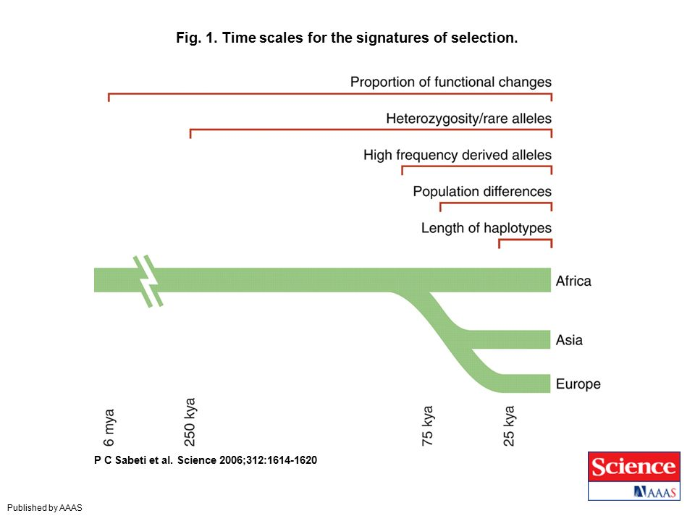
Methods to infer selection
Different methods have different power according to the time and strength of selection

Slide 11
Methods to infer selection
Different methods have different power according to the time and strength of selection

Slide 12
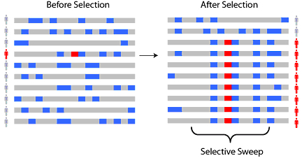
Heterozygosity/rare alleles
As a new positively-selected allele (red) rises to high frequency, nearby linked alleles on the chromosome ‘hitchhike’ along with it to high frequency, creating a ‘selective sweep.’
Ancestral alleles
Derived alleles
Selected allele
Schaffner & Sabeti 2008 Nature Education

Slide 13
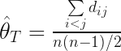
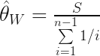
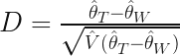
Tajima’s D compares two estimators of genetic diversity: the average number of nucleotide differences ⍬_{T} and the number of segregating sites ⍬_{W}
If the population is at equilibrium: Tajima’s D ~ 0
Rare variants contribute little to the number of pairwise differences
After a selective sweep, the number of segregating sites will be >> than the average number of pairwise differences
Because after a selective sweep, most sequences will be the same -> when mutations occur => rare
rare mutations -> low value of the average number of nucleotide differences in comparison to the number of segregating sites
If number of segregating sites >> average number of pairwise differences => Tajima’s D < 0
Smaller values of Tajima’s D ~ positive selection... or population expansion
https://arundurvasula.wordpress.com/2015/02/18/interpreting-tajimas-d/

Slide 14
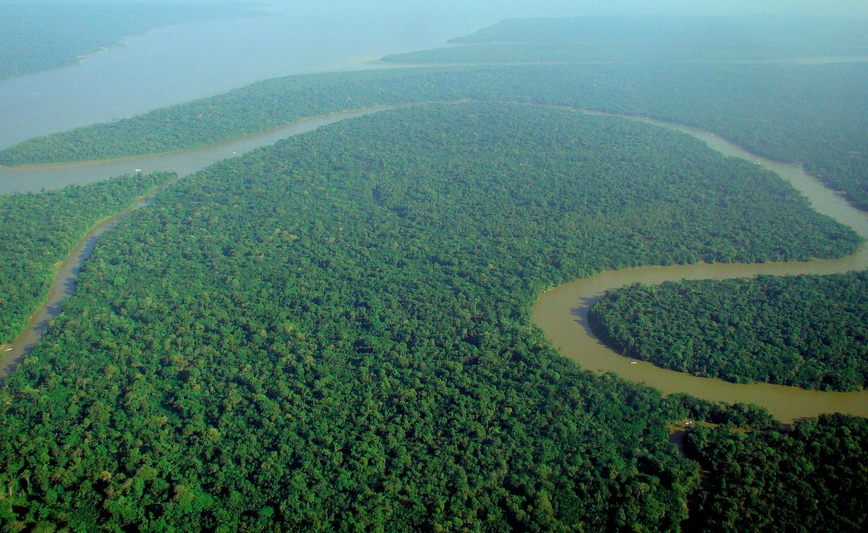
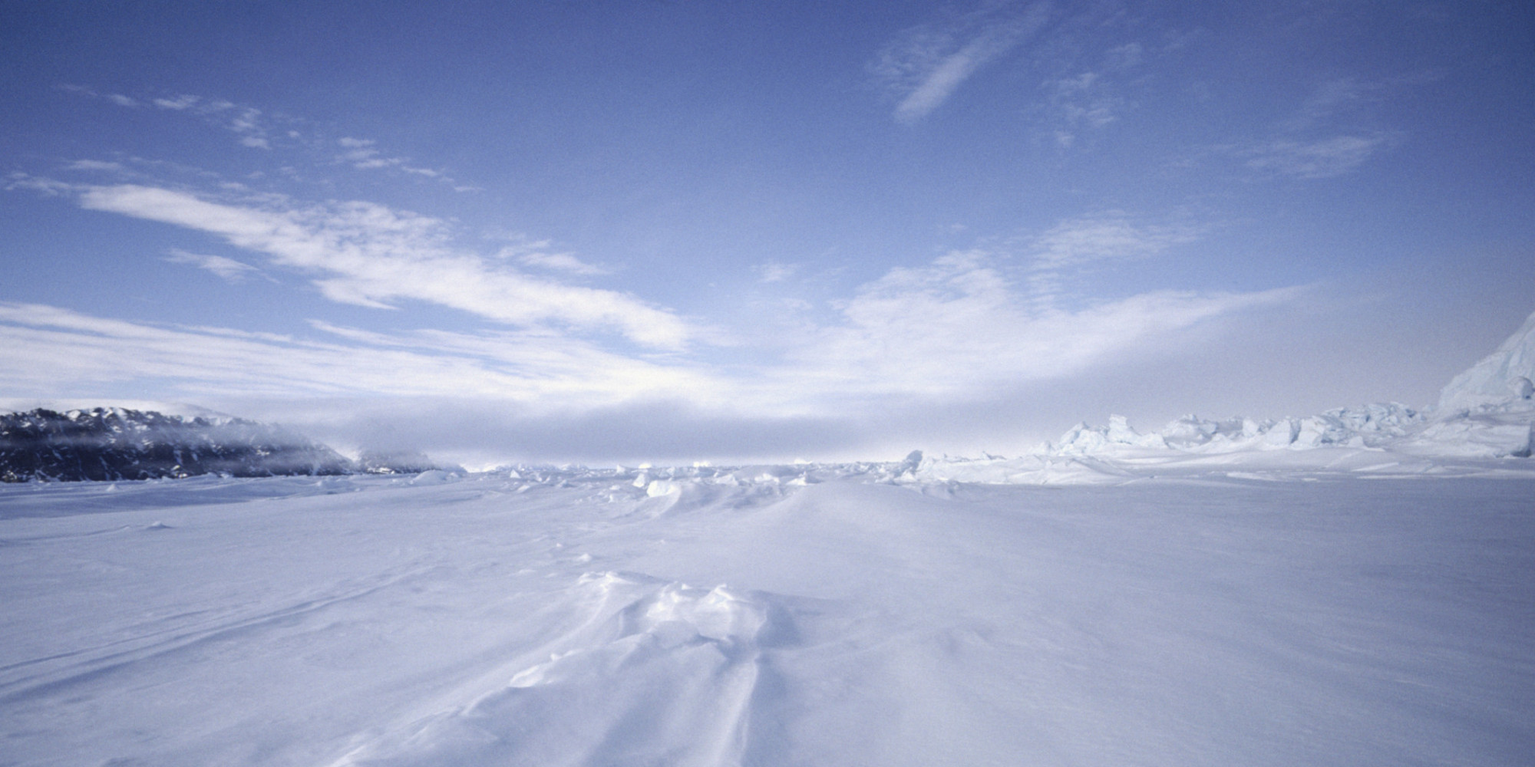
Population differences
Different populations ~ different environments
Different environments ~ distinct adaptive traits
Selection acting in an environment on a locus in a local population but not all populations
Population differentiation can be measured with F_{ST} (Wright’s fixation index): compares the variance of allele frequencies between populations
Large F_{ST} values strong differentiation between populations: directional, positive selection
Small F_{ST} values ~ populations are homogeneous: balancing selection

Slide 15

Length of haplotype
Natural selection leaves footprints on genomes
~ Tajima’s D: selective sweep affects whole haplotypes -> extension
Extended haplotype homozygosity (EHH); long range haplotype(LRH); integrated haplotype score (iHS)

Slide 16
Length of haplotype: the composite iHS statistic
1/ measure EHH ~ the decay of identity as a function of distance of haplotypes that carry a specific (‘core’) allele at one end
EHH varies between 0 and 1, where haplotype homozygosity for the core SNP starts at 1 and decays to 0 with increasing distance from the core SNP
EHH is computed on haplotypes with the ancestral allele and with the derived allele and the area under the curve (EHH decay over distance) is kept ~ integrated EHH (iHH_{A} and iHH_{D})
2/ iHS = iHH_{A}/iHH_{D} , where
iHS=1 if decay is similar between haplotypes carrying either alleles
iHS << 0 if haplotypes carrying the derived allele are longer
iHS >> 0 if haplotypes carrying the ancestral allele are longer
!! Sensitive to allele frequency: adjust/allele frequency and iHS mean and variance

Slide 18
Many tests exist…
PBS and XPEHH ~ population differences
EHH ~ long range haplotypes
Reviews:
Nielsen 2005 Ann Rev Genet
Vitti et al. 2013 Ann Rev Genet

Slide 19
Some examples

Slide 20
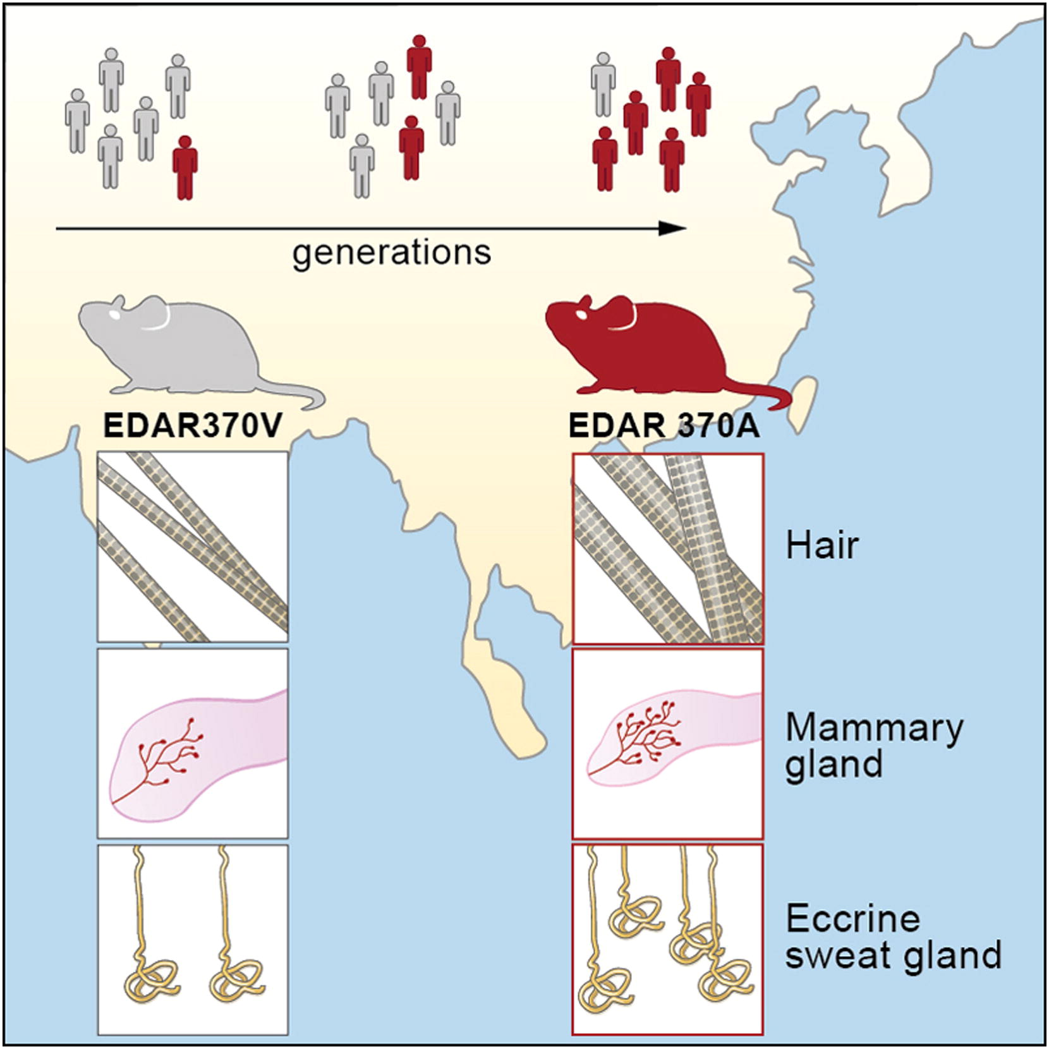
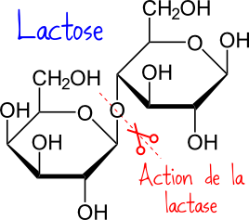
Specific examples for the practical today
Lactase persistence frequency
Lactase activity
Lactase Persistence
birth
2
5
years
Kamberov et al. 2013 Cell
Gerbault et al. 2011 Phil Trans Roy Soc

Slide 21
Aims for the morning
THINK… together ;-)
Series of commands used to generate the files from 1000 genomes data > what do they mean?
Text files with statistics for EDAR~ SNP in Asians and LCT ~ SNP in Europeans > should be read/analysed in R: understand the commands and the statistic
If you’re fast: keep playing or have a break
Any questions: PLEASE ASK :-)

Slide 22
With thanks to… YOU ☺
* Matteo Fumagalli, Imperial College London
* Garrett Hellenthal, University College London
* Andrea Manica, University of Cambridge
Saki Raheem, Linda Percy, Caroline Smith, University of Westminster
Enza and Chiara

